Slide 1
Songbook

Slide 2
What is Songbook?
Songbook is a music streaming service that has a large collection of Indian and International music available free to the users no matter where they are. It is a ONE STEP SOLUTION for all type of music needs.
In Songbook users can create their own playlist , they can add song s of their favourite artist to the playlist and listen to the songs on the go.
Songbook allows users to listen music anytime, anywhere.

Slide 3
Why Songbook?
Songbook has a wide collection of Indian and International music available free to the users easily no matter where they are.
It provides high quality music with just a simple search which makes it more efficient than other music services. The users can listen to the songs online, thus they don't need to download songs.
Songbook allows users to listen to the songs of their favourite artists. It also allows users to choose the song of their favourite genres.

Slide 4
Existing System
In current system, either user has to download songs and keep them in their device storage or buy CDs or DVDs.
Users may not be able to find their favourite artists albums.
There may be a limit to the downloads, the users want songs to get.
The Proposed System overcomes all the limitations of the current System.

Slide 5
How does Songbook Work?
Songbook works by getting data as song or genre or the artist name as its input and using back-end language fetches data from the database accordingly.
User registration and login in the Songbook is very safe as it uses MD5 encryption for password.
After the user registration and login, user searches for the song either by searching for the song directly by its name or searching it by the genre type or the artist name.
The important thing to notice about song book Is that it uses the audio tag of html for playing the song.

Slide 6
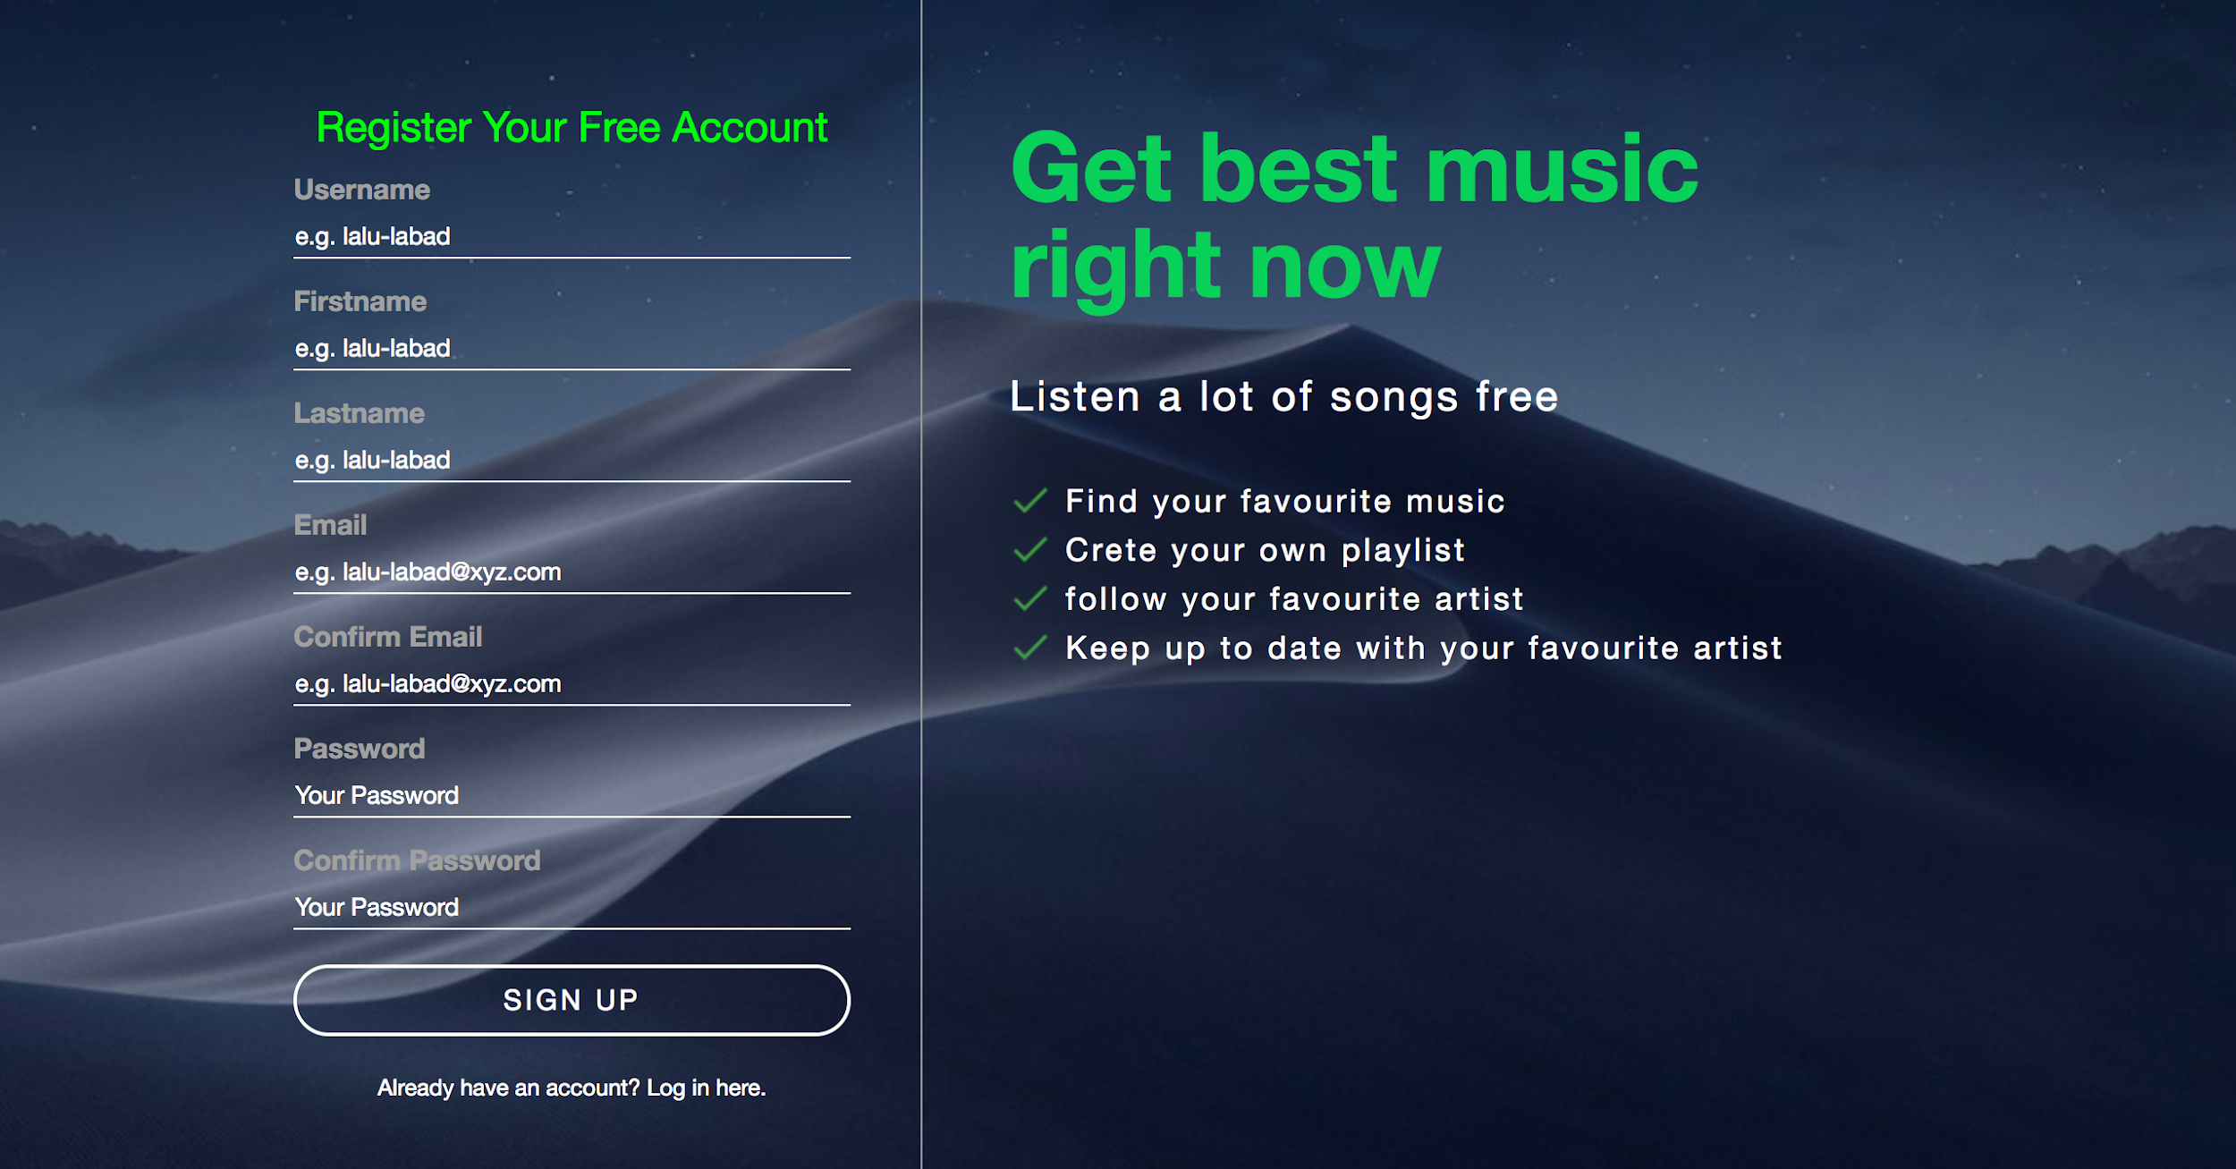
Songbook Registration:

Slide 7
Songbook Registration:
The Flow of the project starts with the Songbook Signing Up.
The user will register into this app by entering the mentioned details.
The Songbook signup is just to ensure that the user becomes the member of the Songbook family.
This data is stored in the database and is further used at the sign in process.

Slide 8
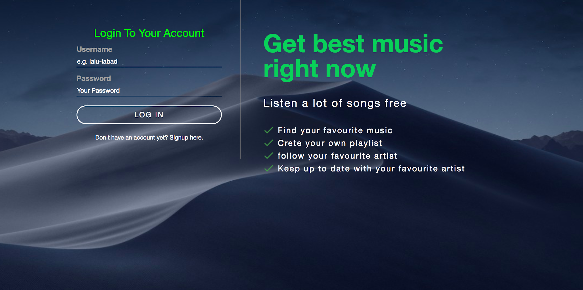
Songbook Login:

Slide 9
Songbook Login:
The user is needed to Login with the credentials – Username and Password before using the features of the Songbook.
After verifying credentials entered by the user through database he/she is allowed to enter the homepage of the Songbook.
From homepage user can enjoy the features of the Songbook.

Slide 10
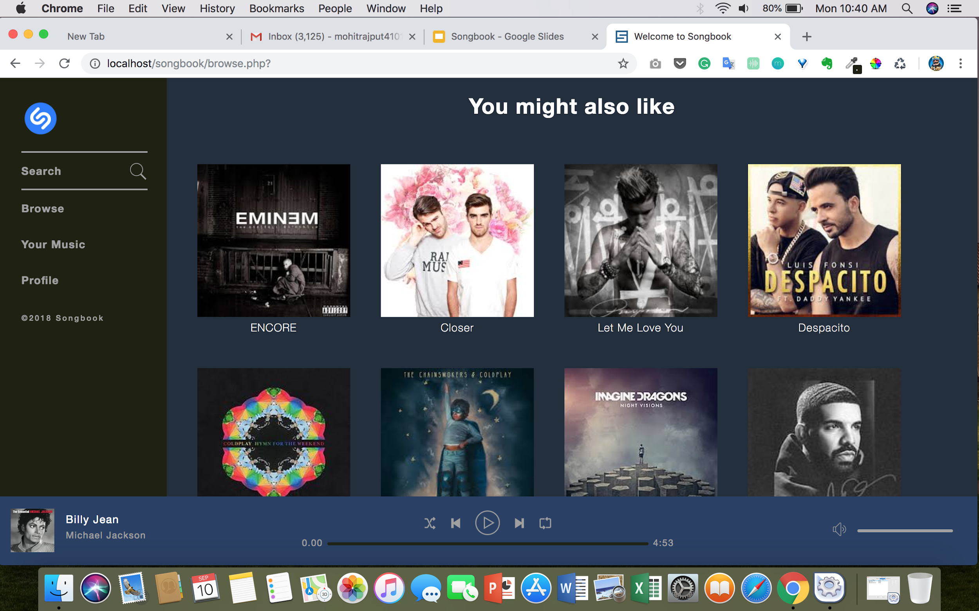
Songbook homepage

Slide 11
Songbook Homepage
The homepage has functionality of searching songs by artists name, song name.
Users can create their own playlist by adding their favourite songs.
Song is played through interaction with the media player and through the audio tag of html5.
The browse option shows the album of the artists clicking which, songs
of that particular artist are seen.

Slide 12
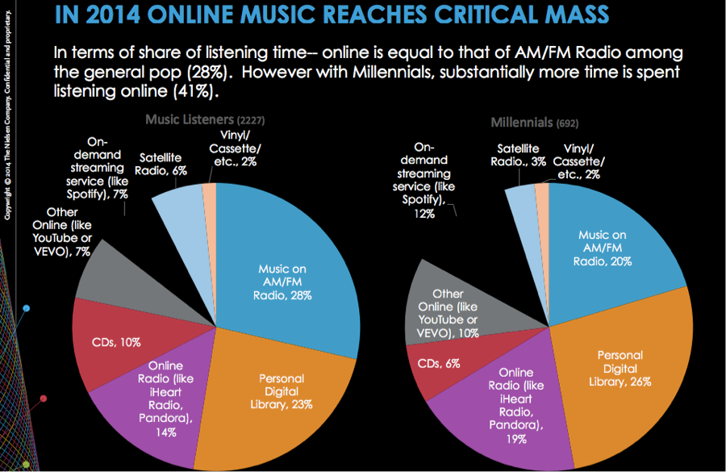
Survey results on online music streaming

Slide 13
Thank You

